Slide 1
EDA for Loan Default Risk Analysis
Understanding Driving Factors Behind Loan Defaults
Siddharth

Slide 2
AGENDA
01
Problem Statement
04
Key Takeaways
Recommendations
Conclusion
02
Business Objective
05
CLOSING
Questions
Thank You
03
Analytical Approach
Univariate Analysis
Bivariate Analysis
Defaulter Analysis
Correlation Heatmap

Slide 3
Problem Statement
The aim is to identify patterns in loan applicants' data to predict potential defaulters.
Help the company minimize credit loss by understanding the variables influencing defaults.
Focus on risk analytics in lending and financial services.

Slide 4
Business Objective
To reduce financial losses by identifying high-risk loan applicants.
Use exploratory data analysis (EDA) to understand consumer and loan attributes that influence default tendencies.
Enable data-driven decision-making for loan approvals.

Slide 5
Dataset Overview
Time Period: 2007 to 2011.
Key Variables: Loan Amount, Interest Rate, Loan Grade, Annual Income, Loan Status.
Highlight: "Dataset includes applicants who either fully paid, are currently paying, or defaulted (Charged Off)."

Slide 6
Analytical Approach
Steps in Analysis:
Data Cleaning and Preparation.
Univariate Analysis: Examining individual variables.
Bivariate Analysis: Understanding relationships between two variables.
Multivariate Analysis: Exploring interactions among multiple variables.

Slide 7
Univariate Analysis
Loan Amount Distribution: Most loans are concentrated in the mid-range amounts.
Interest Rate Distribution: Interest rates follow a normal-like distribution.
Graphs: Include the histograms for loan amount and interest rate.

Slide 8
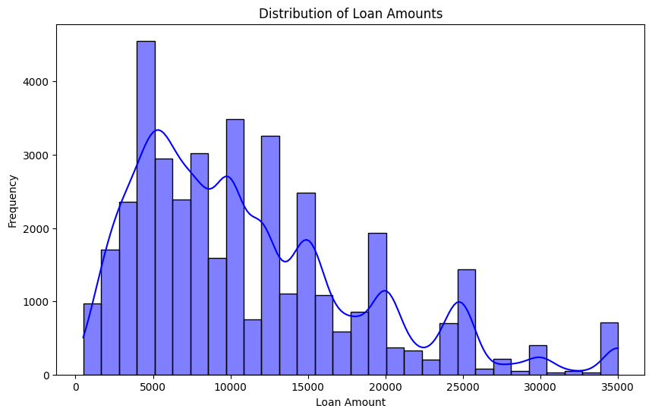
Distribution of Loan Amounts
This histogram shows the distribution of loan amounts in the dataset, helping to identify the most common loan sizes and their spread.

Slide 9
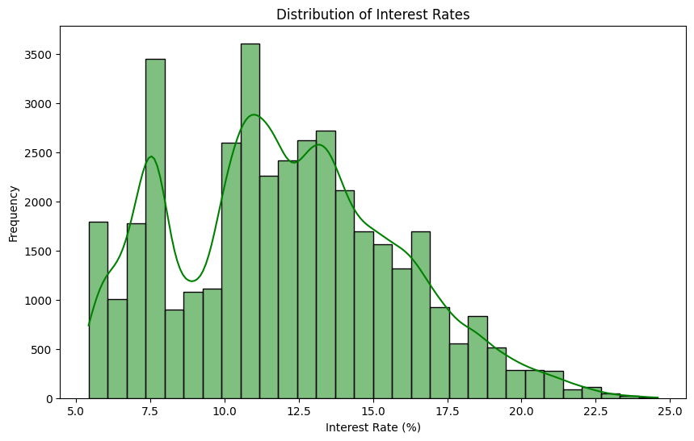
Distribution of Interest Rates
This plot illustrates how interest rates are distributed, providing insights into the range and common values of interest rates offered.

Slide 10
Bivariate Analysis
Loan Amount vs. Interest Rate: Higher loan amounts correlate with slightly lower interest rates.
Loan Status Distribution: Most loans are either fully paid or current; a smaller percentage are charged-off.
Graphs: Include scatter plot and loan status count plot.

Slide 11
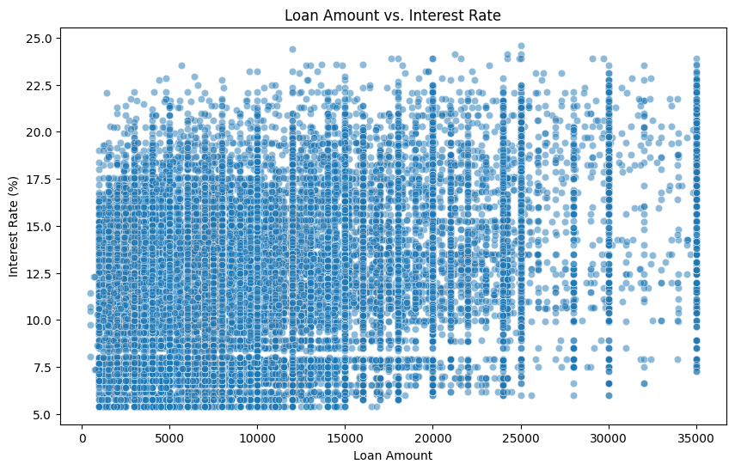
Loan Amount vs. Interest Rate
A scatter plot depicting the relationship between loan amounts and interest rates, showing any patterns or trends between these two variables.

Slide 12
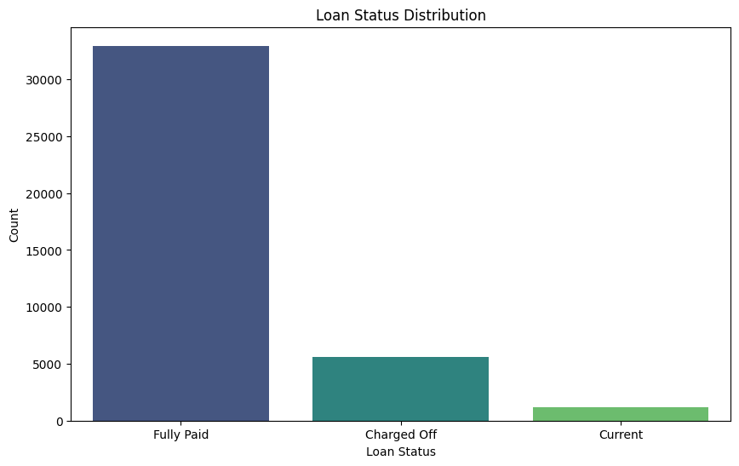
Loan Status Distribution
A count plot showing the distribution of loan statuses, revealing how loans are categorized (e.g., Fully Paid, Charged Off).

Slide 13
Defaulter Analysis
Charged-Off Loan Amounts: Higher frequency in smaller loan amounts.
Charged-Off Interest Rates: Generally, higher interest rates are associated with defaults.
Grade Distribution: Lower grades (e.g., D, E) have a higher proportion of defaults.
Graphs: Histograms for charged-off loans and grades.

Slide 14
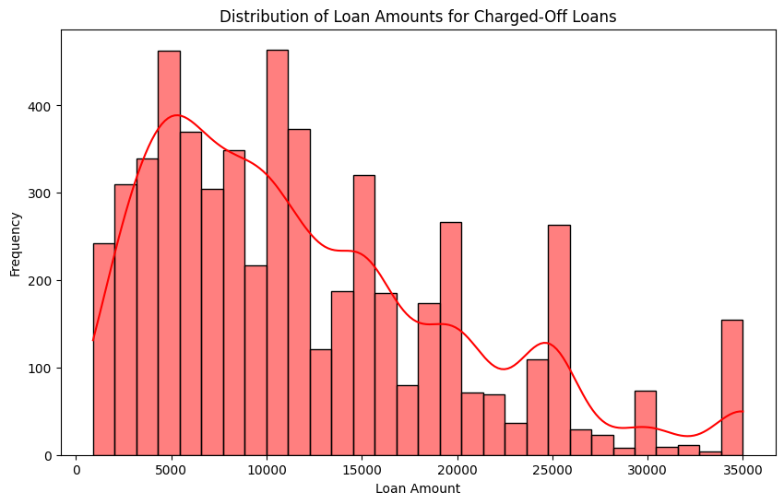
Distribution of Loan Amounts for Charged-Off Loans
A histogram focusing on loan amounts specifically for charged-off loans, providing insights into their typical sizes.

Slide 15
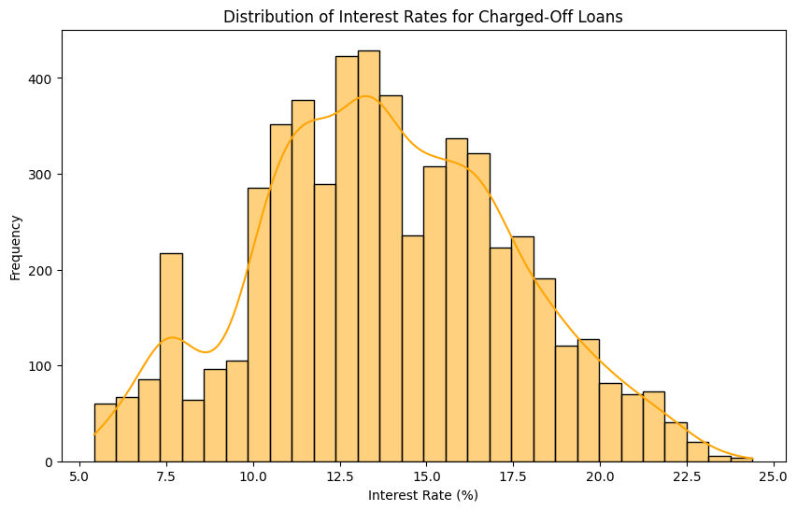
Distribution of Interest Rates for Charged-Off Loans
This plot visualizes the distribution of interest rates for charged-off loans, helping identify whether higher interest rates correlate with loan defaults.

Slide 16
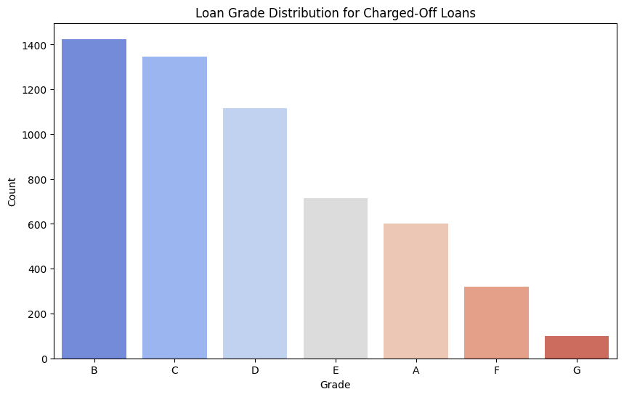
Loan Grade Distribution for Charged-Off Loans
A bar chart representing the grade distribution for charged-off loans, showing which grades are more prone to defaults.

Slide 17
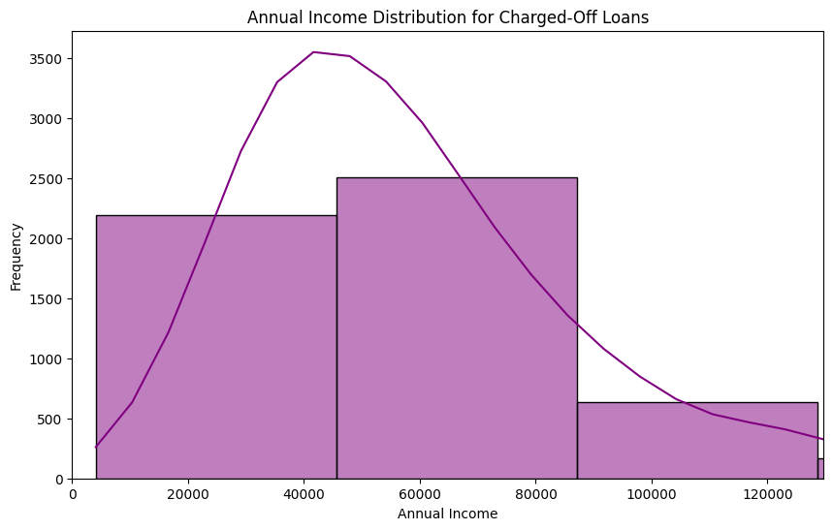
Annual Income Distribution for Charged-Off Loans
A histogram of annual incomes for borrowers with charged-off loans, focusing on incomes below the 95th percentile to reduce skewness.

Slide 18
Correlation Heatmap
Highlights strong relationships among variables.
Insight: "Interest rate negatively correlates with loan grades."
Graph: Include the heatmap visualization.

Slide 19
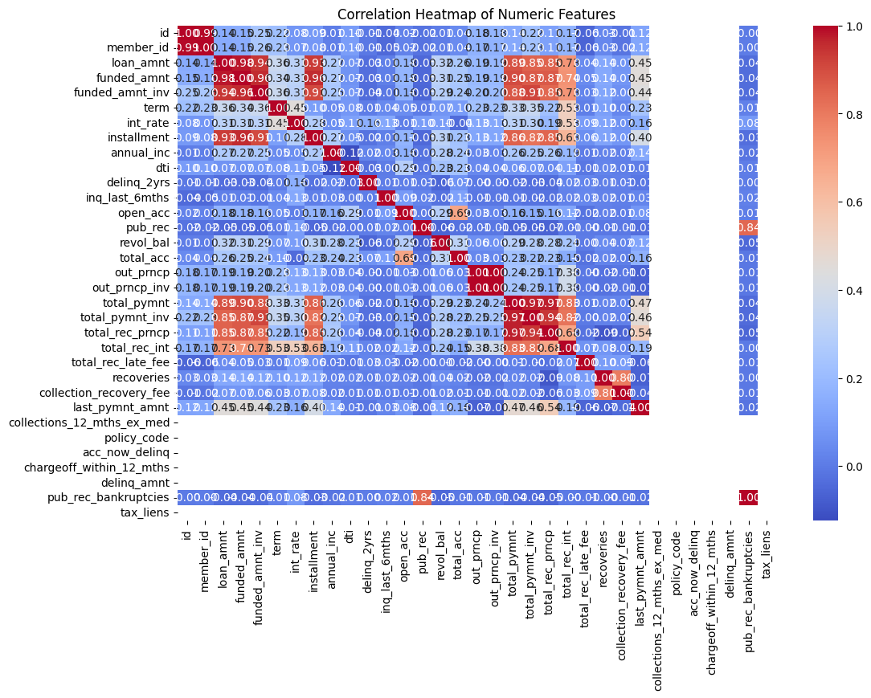
Correlation Heatmap of Numeric Features
A heatmap showing correlations between numeric variables in the dataset, highlighting strong positive or negative relationships among features.

Slide 20
Low-grade loans and higher interest rates are major predictors of defaults.
Loan amounts in the lower range show higher default tendencies.
Income segmentation can improve loan risk assessment.
Key Takeaways

Slide 21
Focus on stringent screening for low-grade applicants.
Adjust interest rates dynamically based on risk profile.
Limit exposure to loans with high default risk.
Recommendations

Slide 22
EDA reveals critical insights for minimizing credit loss.
Identifying high-risk applicants is essential for sustainable lending.
Insights can guide better portfolio and risk management strategies.
Conclusion

Slide 23
THANK YOU

